Slide 1
On Supporting Ethical Decisions in Connected and Autonomous Vehicle Scenarios
Shreyas Setlur Arun
Matricola: 267360
Relatore: Prof. Paola Inverardi
Presented by:
Shreyas Setlur Arun
Matricola:267360
‹#›

Slide 2
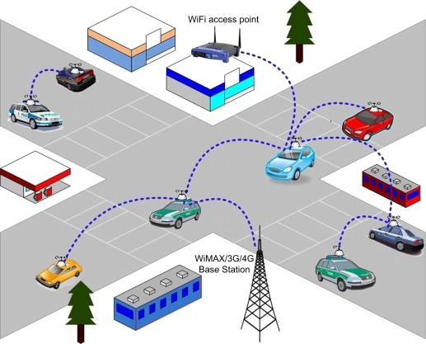
Agenda
Introduction - VANETs, ITS
Ethics - Hard and Soft Ethics
Architecture
Simulation
Results
Conclusion and Future Work

Slide 3
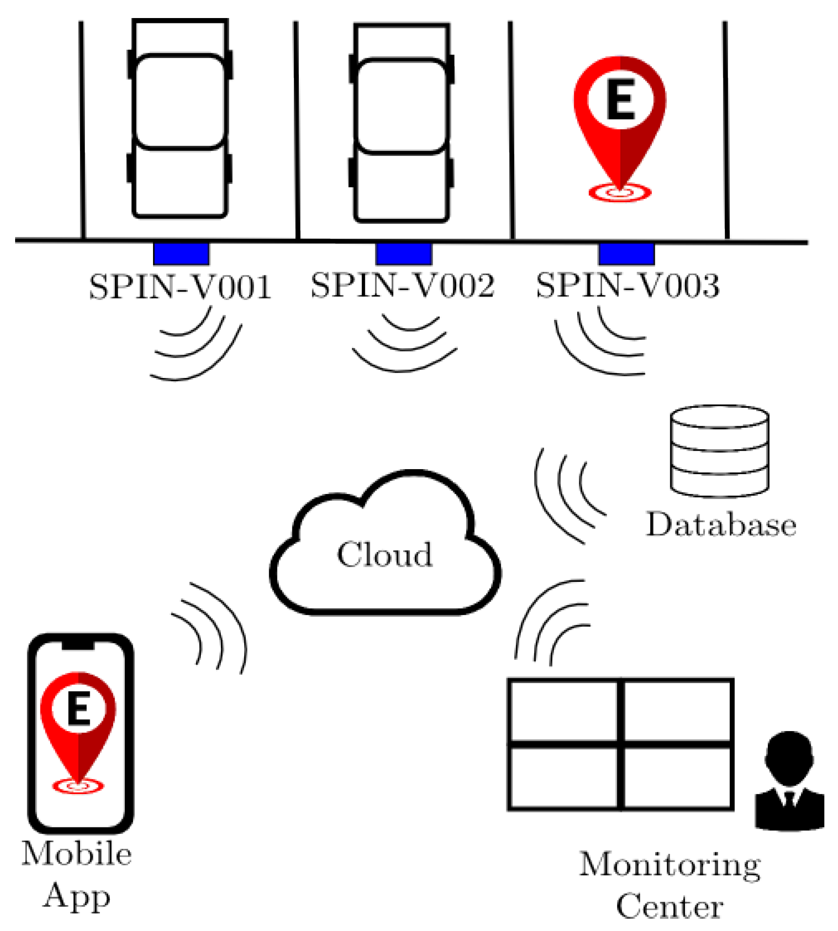
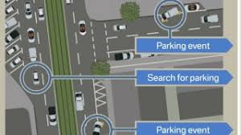
VANETS
Reference: Ali, Ghulam, et al. "IoT based smart parking system using deep long short memory network." Electronics 9.10 (2020): 1696.

Slide 4
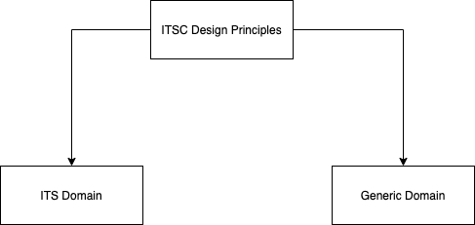
Intelligent Transport Systems
ITS Domain: All elements of ITSC which are specified in ITS/ITSC standards.
Generic Domain: Other elements used for ITS
Factors affecting ITS standards:
Mobility of ITS stations
Communication technology resources like Internet, Bluetooth etc
User needs
Potential support for interaction with other applications
Source: ETSI Standards 2020

Slide 5
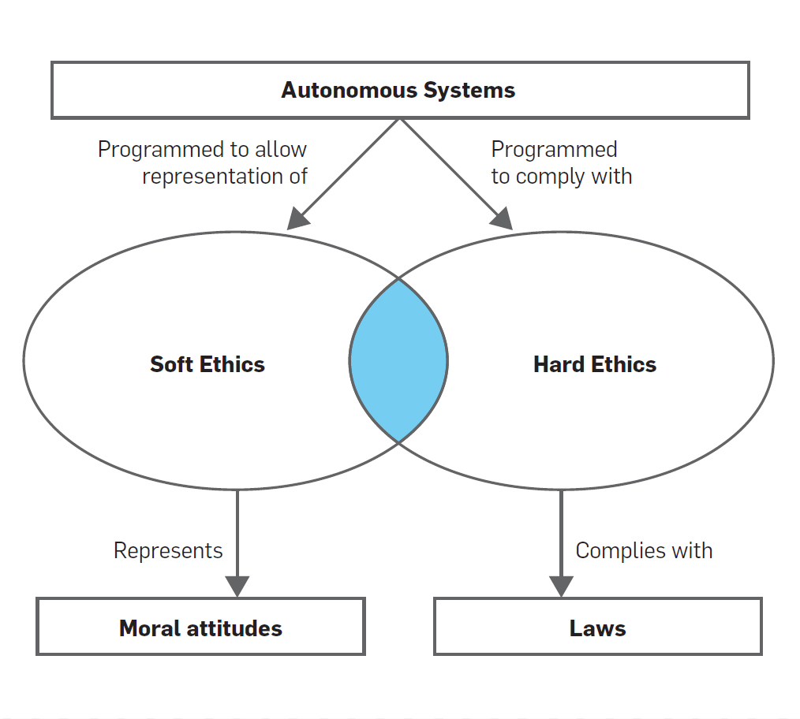
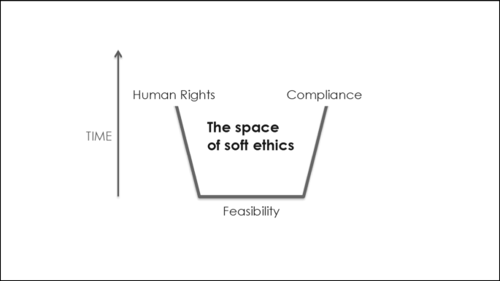
Ethics
Hard-Ethics: Digital ethics defined and modulated by legislation.
Soft-Ethics: Digital ethics which are moral decisions over and above the existing regulation, without trying to bypass or change the hard ethics
Reference: M. Autili, D. D. Ruscio, P. Inverardi, P. Pelliccione, and M. Tivoli. A software exoskeleton to protect and support citizen’s ethics and privacy in the digital world. IEEE Access, 7:62011– 62021, 2019.

Slide 6
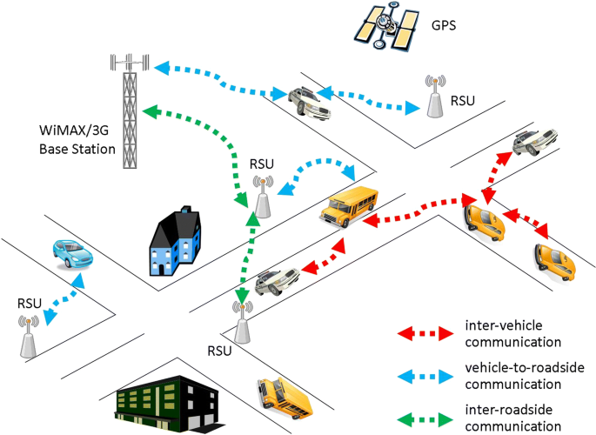
Research Questions
What is the kind of architecture which might support ethical messaging services?
What are the categories of ethical content that can be transmitted?

Slide 7
Use Case
Setting: A parking lot in a big mall
Resource contention: Two autonomous connected vehicles (named A and B hereafter), with one passenger each, are competing for the same parking lot. Passenger of vehicle A is pregnant.
Context: A and B are rented vehicles, therefore, they are multi-user and have a default ethics that determines their decisions.
Objective
Propose an architecture which depicts the ethical decision making mechanisms along with messaging to other vehicles.

Slide 8
Assumptions
The smart parking system is considered as a black box.
Infrastructure for the road side communication is already installed.
Users in the cars are able to connect with each other through a messaging medium of the cars
Failures in communication are not considered in the scope of the project.
A communication channel is established for communication between the vehicles.

Slide 9
Priorities
The passenger can set the priority in the ethical engine through the user interface. There can be 3 levels of priorities namely:
Level 1 : Critical priority
Level 2: Important priority
Level 3: Normal priority
Critical priority: Disorders like heart ailment, accident related issues, blood loss issues
Important priority: Old age issues, physically handicapped, mentally handicapped, pregnancy
Normal priority: All other ailments

Slide 10
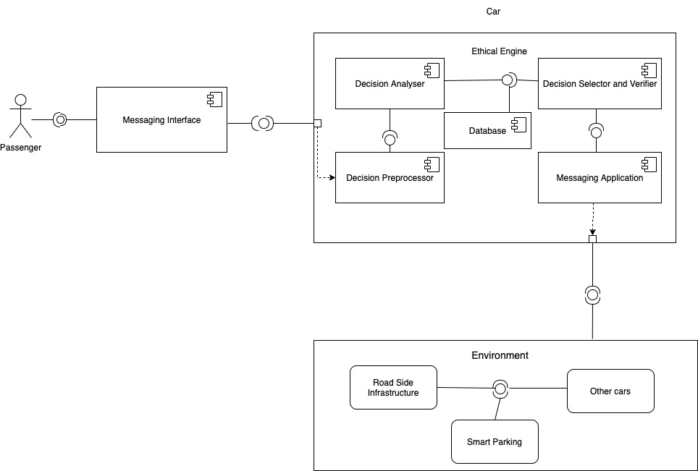
Component Diagram

Slide 11
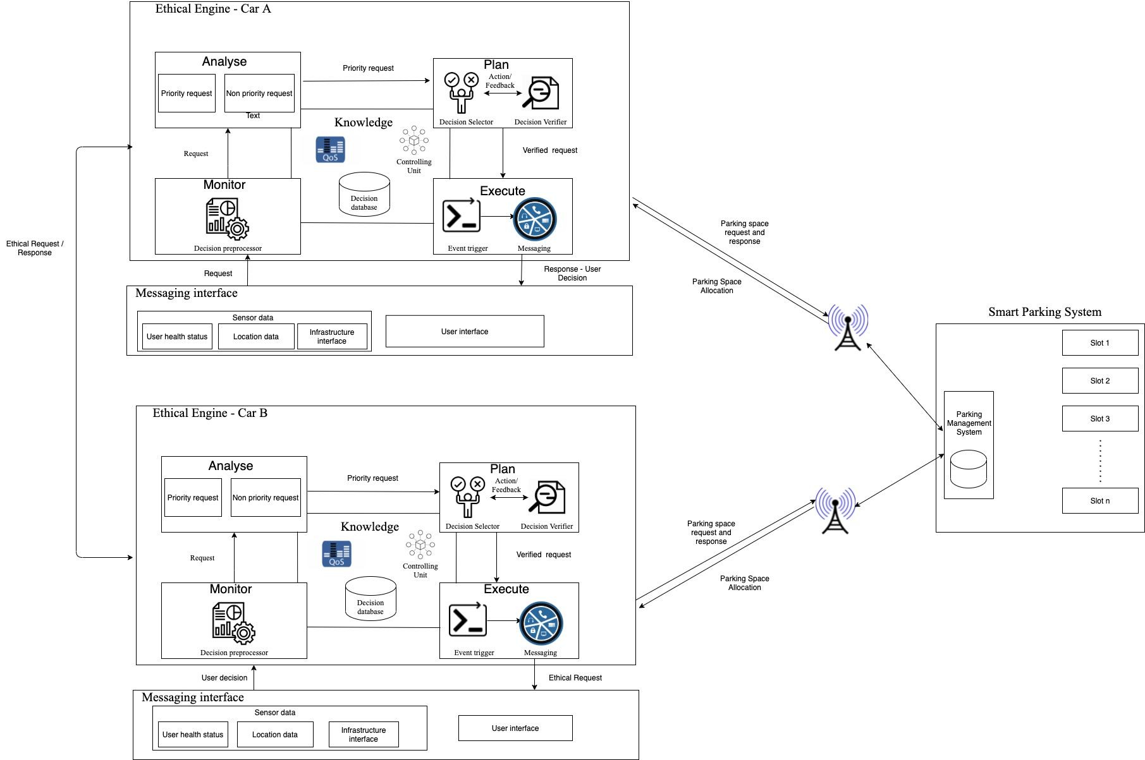
Architecture
Some compenets inspired from J. Cámara, H. Muccini, and K. Vaidhyanathan. Quantitative verification-aided machine learning: A tandem approach for architecting self-adaptive iot systems. In 2020 IEEE International Conference on Software Architecture (ICSA), pages 11–22. IEEE, 2020.

Slide 12
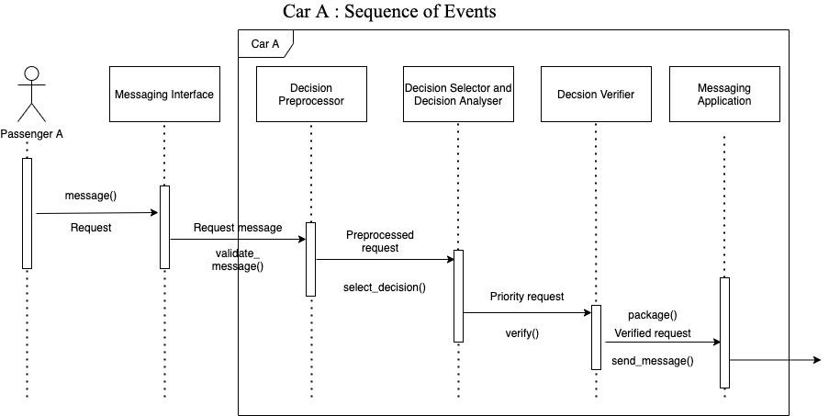
Sequence Diagrams - Car A

Slide 13
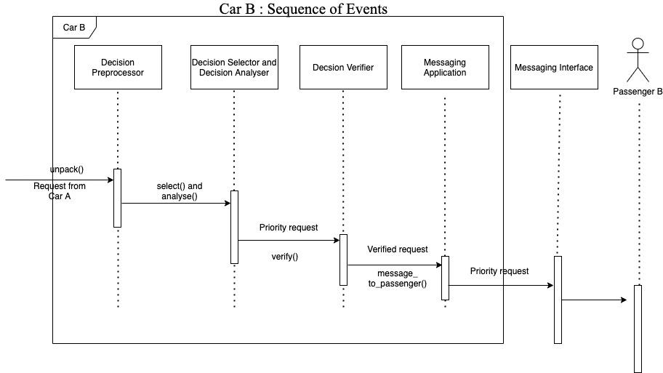
Sequence Diagram - Car B

Slide 14
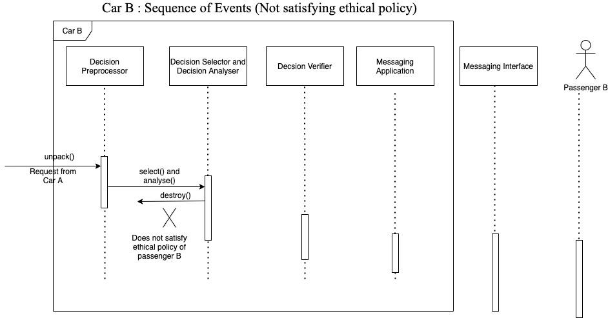
Sequence Diagram - Car B ( Not satisfying ethical priorities)

Slide 15
Scenarios and Role of MAPE-K loop
When an unknown priority request is raised the knowledge base of the ethical engine of the car is updated and the request is given a default priority of level 3. The priority level of the request can be updated at a later stage.
The incoming messages are sent to passenger B when it matches the priority level set by them.
The outgoing messages have a priority set by passenger A before the message is sent.
The priorities of the passenger can be set based on their health status from previous records.
Role of MAPE - K
MAPE-K loop plays a huge role in design of adaptable software systems for the following reasons:
Maintaining the capability to adapt the functionality according to changes in the environment.
Adapts behavioural changes with respect the security of the system
Is able to maintain a large, complex system taking decisions at run time
Interact with several components and make a decision
Able to enhance security aspects of the design and deployed systems

Slide 16
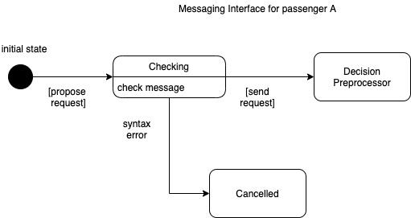
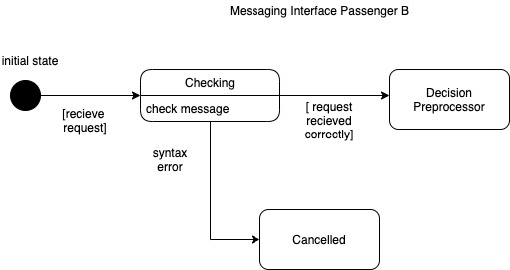
State Diagrams - Messaging Interface
The messaging interface of passenger A is sending the message in this scenario. There is a syntactic check in both the diagrams.

Slide 17
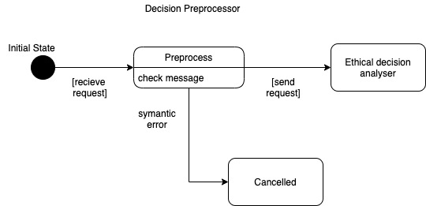
State Diagram - Decision Preprocessor
The decision preprocessor behavior is the same in the case of both sending a message as well as receiving a message. It receives a message from the messaging interface for preprocessing. It does the semantic error checking.

Slide 18
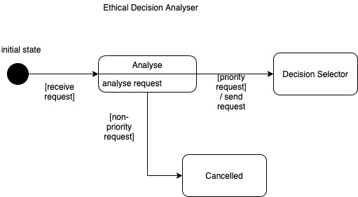
State Diagrams - Ethical Decision Analyzer
The ethical decision analyzer plays a major role in the receiving scenarios. It analyses whether the message is an ethical message.

Slide 19
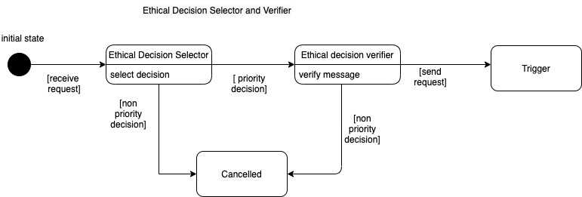
State Diagram - Decision Selector and Verifier
The ethical decision selector plays an important role in sending scenarios. It helps in selecting the right priority for the request and then verifies it.

Slide 20
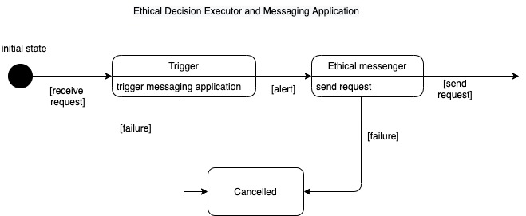
State Diagram - Decision Executor & Messaging Application
The ethical decision executor consists of a trigger and a messaging application. The trigger is activated when the message is to be sent over the public network. The ethical messenger send the request over the network.

Slide 21
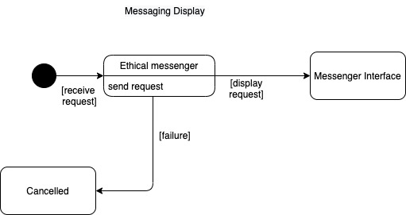
State Diagram - Message Display
The passenger is displayed the message by the ethical messenger in case it satisfies the ethical priorities set by him/ her.

Slide 22
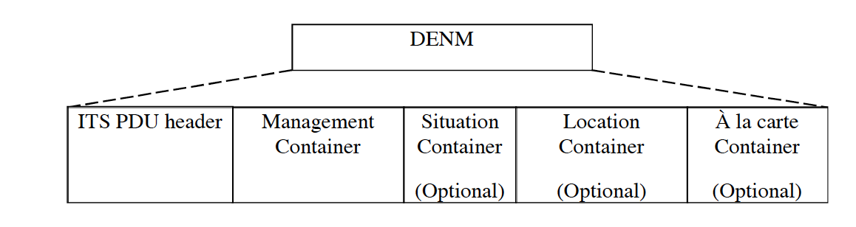
ETSI Standard DENM Messaging
Image source: ETSI Standard Document 2020

Slide 23
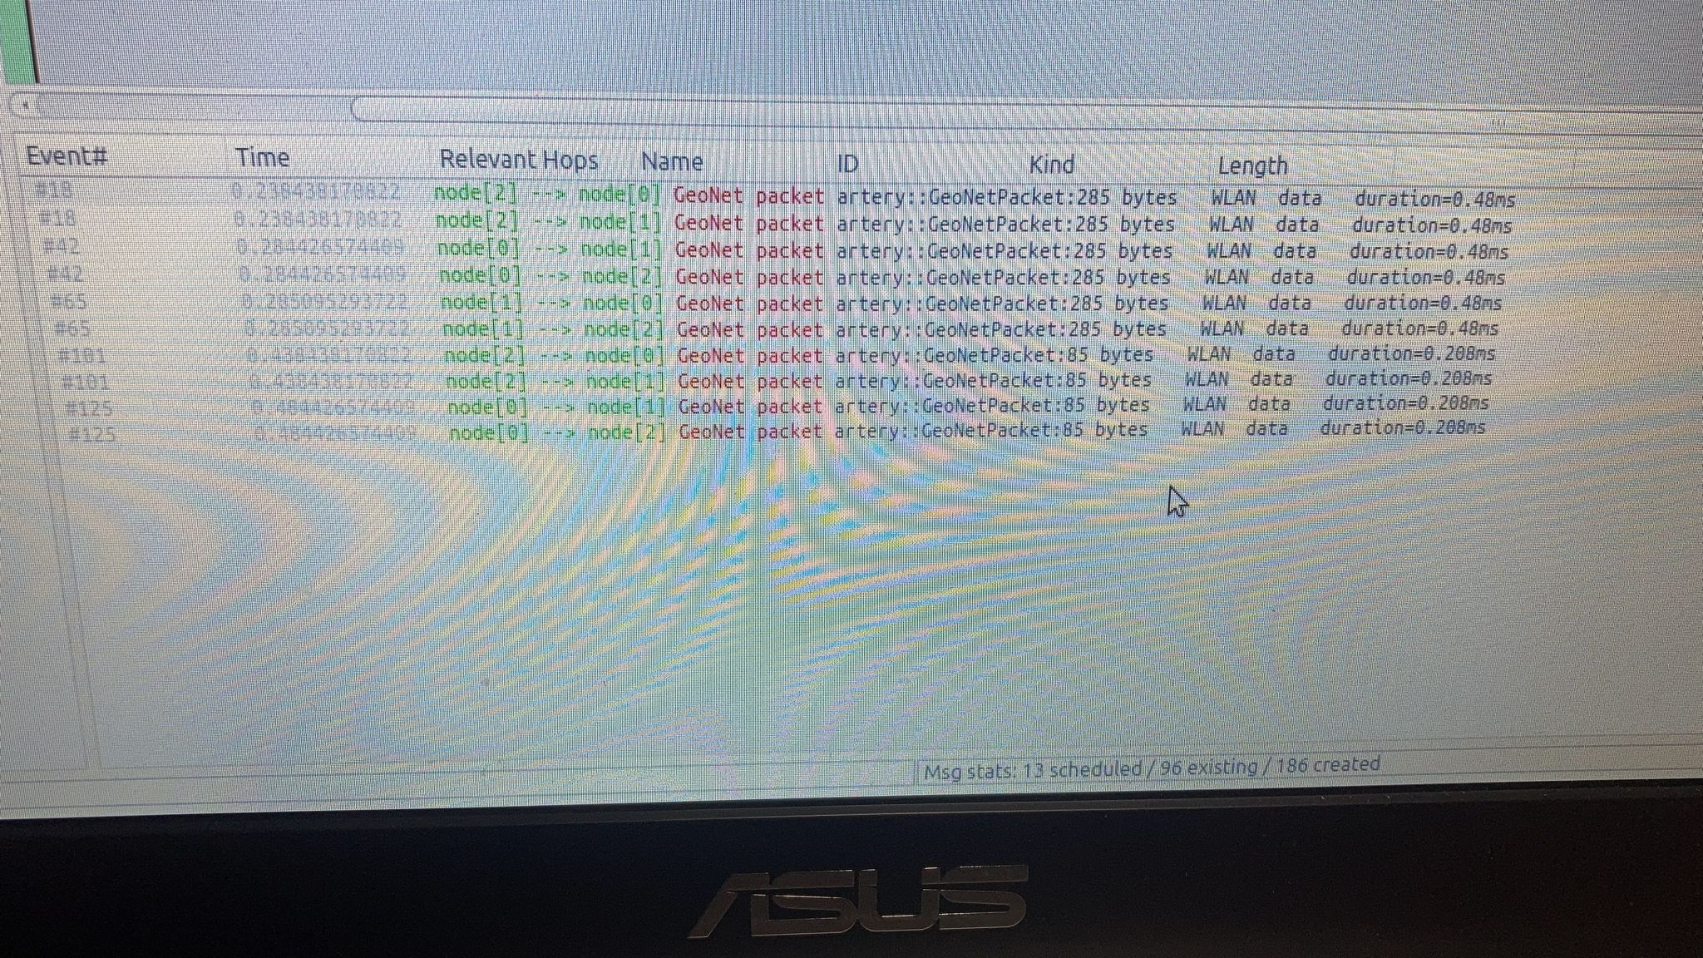
Simulation
The goal of the simulation is to integrate ethical communication with the present state of art infrastructure used in communication between cars, humans and other roadside infrastructure.
The simulation environment consisted of the following components:
Artery Software
ASUS laptop - N76V
Ubuntu Operating System
OMNET++, VEINS and SUMO simulators
Programming language used: C++

Slide 24

Simulation Video

Slide 25
Results
The major goal of this simulation of integrating ethical messages with existing infrastructure was feasible.
Different levels of priorities were assigned to the cars and the communication between them was possible through radio wave mechanism.
The distance range is measured to be 500 meters.
Simulation of cars being able to communicate with each other was possible using the DENM messaging pattern.
Different infrastructure communication is possible with the software. However, car to car and car to infrastructure was explored.

Slide 26
Conclusion and Future Work
The learning’s from this research work are as follows:
The opportunity to explore the open source vehicle communication simulator.
Interaction with web based or android based system was not supported in the current version of software.
Various plugins were experimented with to install the packages.
Libraries that support the software were not easily accessible and took a lot of time to install initially.
Got several opportunities to interact with industrial experts through seminars and workshops.
The capabilities of the messaging system to be explored with various technologies.
The real time implementation with web based interfaces is to be explored.

Slide 27
References
[1] M. Autili, D. D. Ruscio, P. Inverardi, P. Pelliccione, and M. Tivoli. A software exoskeleton to protect and support citizen’s ethics and privacy in the digital world. IEEE Access, 7:62011– 62021, 2019.
[2] J. Cámara, H. Muccini, and K. Vaidhyanathan. Quantitative verification-aided machine learning: A tandem approach for architecting self-adaptive iot systems. In 2020 IEEE International Conference on Software Architecture (ICSA), pages 11–22. IEEE, 2020.
[3] A. Djajadi and R. J. Putra. Inter-cars safety communication system based on android smartphone. In 2014 IEEE Conference on Open Systems (ICOS), pages 12–17. IEEE, 2014.
[4] D. Eckhoff, N. Sofra, and R. German. A performance study of cooperative awareness in etsi its g5 and ieee wave. In 2013 10th Annual Conference on Wireless On-demand Network Systems and Services (WONS), pages 196–200. IEEE, 2013.
[5] L. Floridi. Soft ethics and the governance of the digital. Philosophy & Technology, 31(1):1–8, 2018.
[6] M. Fowler. UML Distilled. Booch Jabcon Rambaugh, 2003.
[7] N. J. Goodall. Ethical decision making during automated vehicle crashes. Transportation Research Record, 2424(1):58–65, 2014.
[8] P. Inverardi. The european perspective on responsible computing. Commun. ACM, 62(4):64– 64, Mar. 2019.
[9] B. Kovacevic, M. Kovacevic, T. Maruna, and D. Rapic. Android4auto: A proposal for integration of android in vehicle infotainment systems. In 2016 IEEE International Conference on Consumer Electronics (ICCE), pages 99–100. IEEE, 2016.
[10] C. Obermaier, R. Riebl, and C. Facchi. Dynamic scenario control for vanet simulations. In 2017 5th IEEE International Conference on Models and Technologies for Intelligent Transportation Systems (MT-ITS), pages 681–686. IEEE, 2017.
[11] R. S. Raw, M. Kumar, and N. Singh. Security challenges, issues and their solutions for vanet. International journal of network security & its applications, 5(5):95, 2013.
[12] R. Riebl. Artery framework. http://artery.v2x-research.eu/. Accessed: 2021-10-08.
[13] R. Silva and R. Iqbal. Ethical implications of social internet of vehicles systems. IEEE Internet of Things Journal, 6(1):517–531, 2018.
[14] A. Taeihagh and H. S. M. Lim. Governing autonomous vehicles: emerging responses for safety, liability, privacy, cybersecurity, and industry risks. Transport reviews, 39(1):103–128, 2019.

Slide 28


